Slide 1


Improvement of Toffoli-n gate fidelity for Grover’s search algorithm
Subtitle : Confirm QPU system stability
Hwan-Seop Yeo, Seungwook Woo, Beomgyu Choi
2022-June.-8th
Week 3
Notes:
Good morning, In this presentation, I’d like to talk about on-going research, The growth and optical characterization of a site-controlled thee-fold symmetric III-nitride quantum dot grown by MOCVD

Slide 2
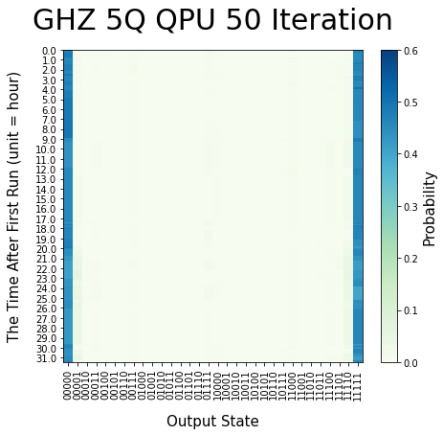
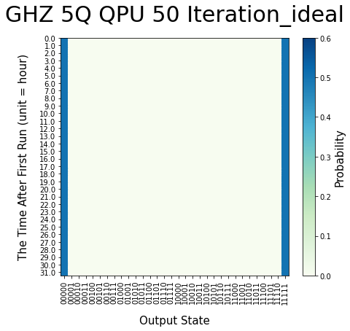
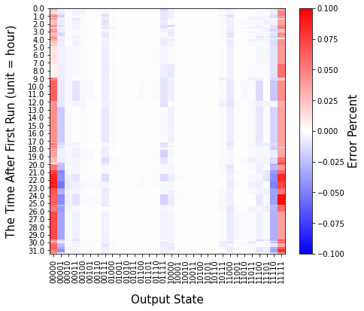
Work done 1: Test Stability of IonQ QPU
QPU
Ideal
Probability
Probability
-
=
Errors
-
=

Slide 3
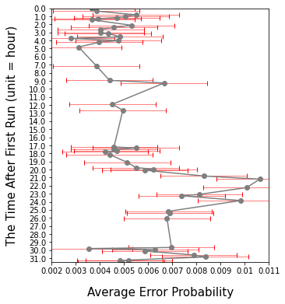
Work done 1: Test Stability of IonQ QPU
Errors
->
Get Average Error Value of each iteration
(Average of) (Absolute Value)
->
Average
Error

Slide 4
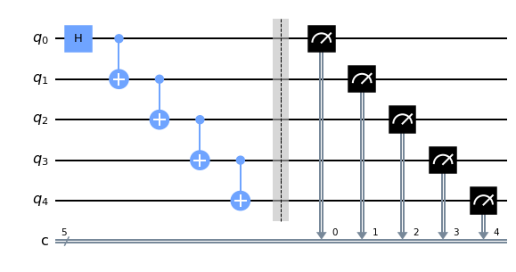
Work done 1: Test Stability of IonQ QPU
GHZ state 1
Probability
Errors
Average
Error

Slide 5
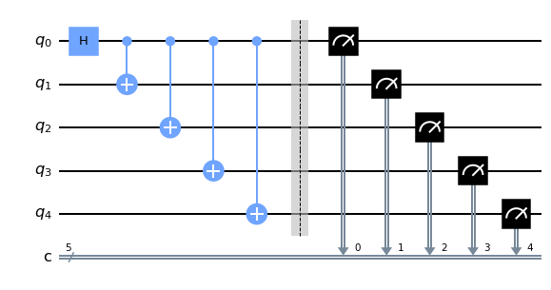
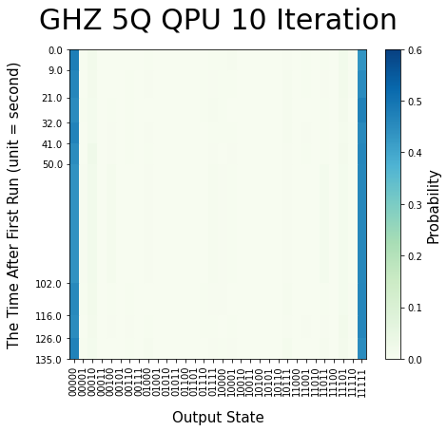
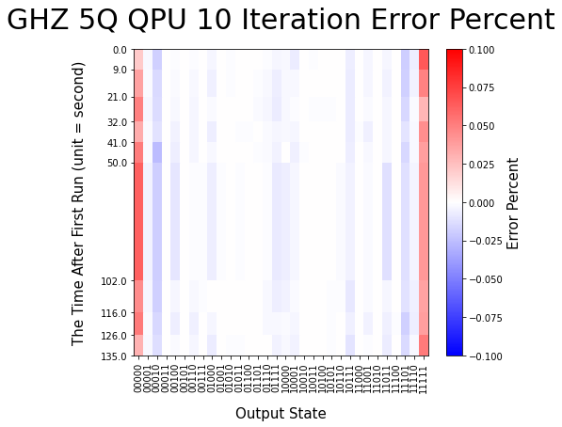
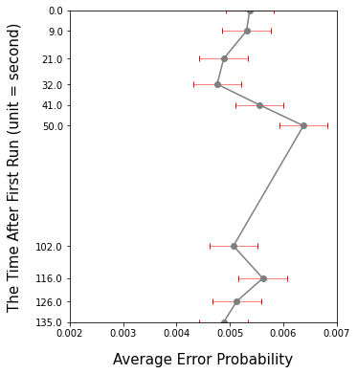
Work done 1: Test Stability of IonQ QPU
GHZ state 2
Probability
Errors
Average
Error

Slide 6
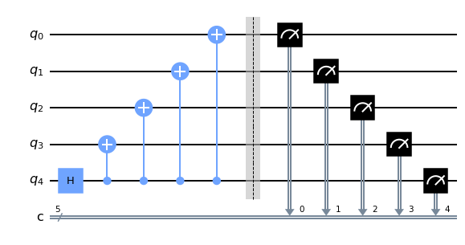
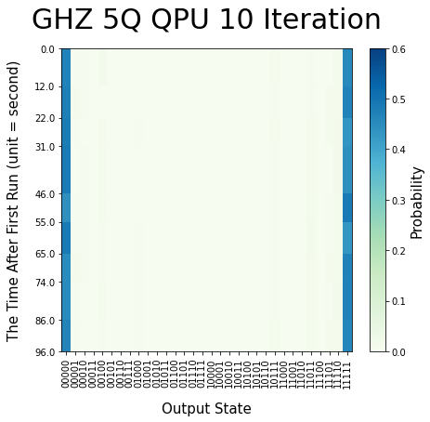
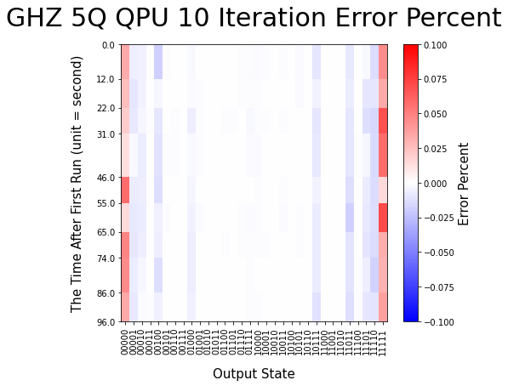
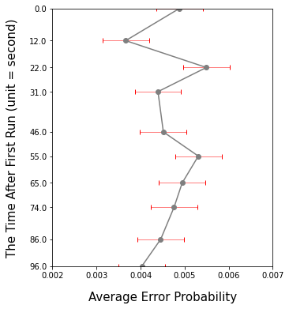
Work done 1: Test Stability of IonQ QPU
GHZ state 3
Probability
Errors
Average
Error

Slide 7
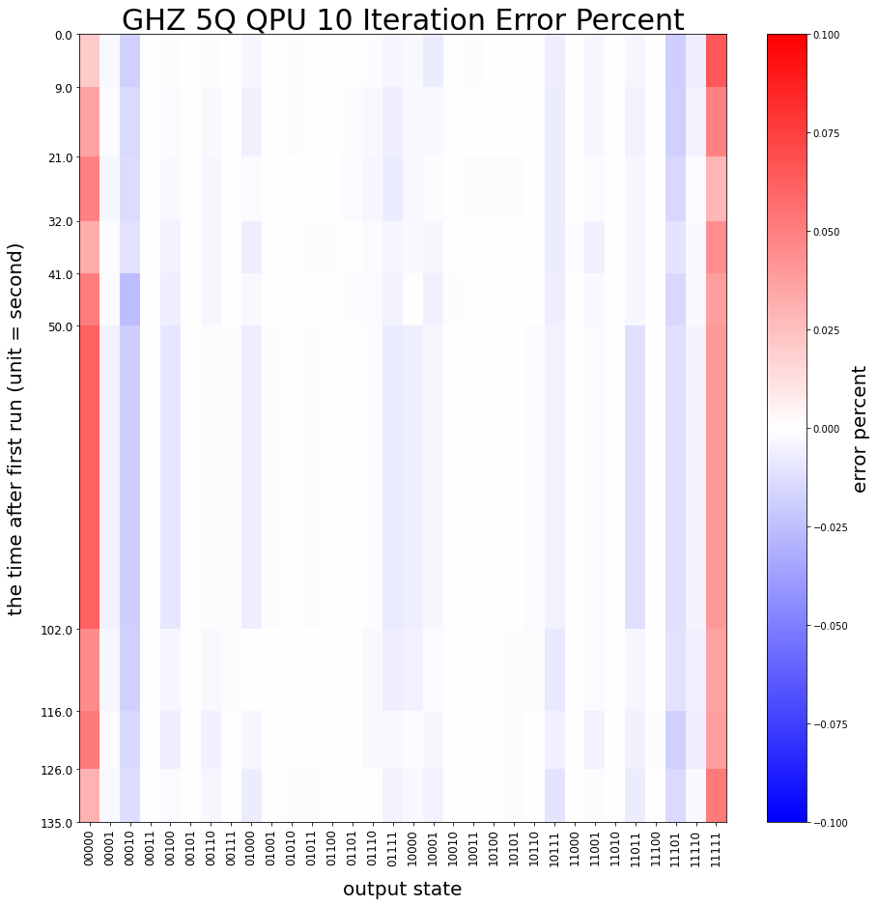
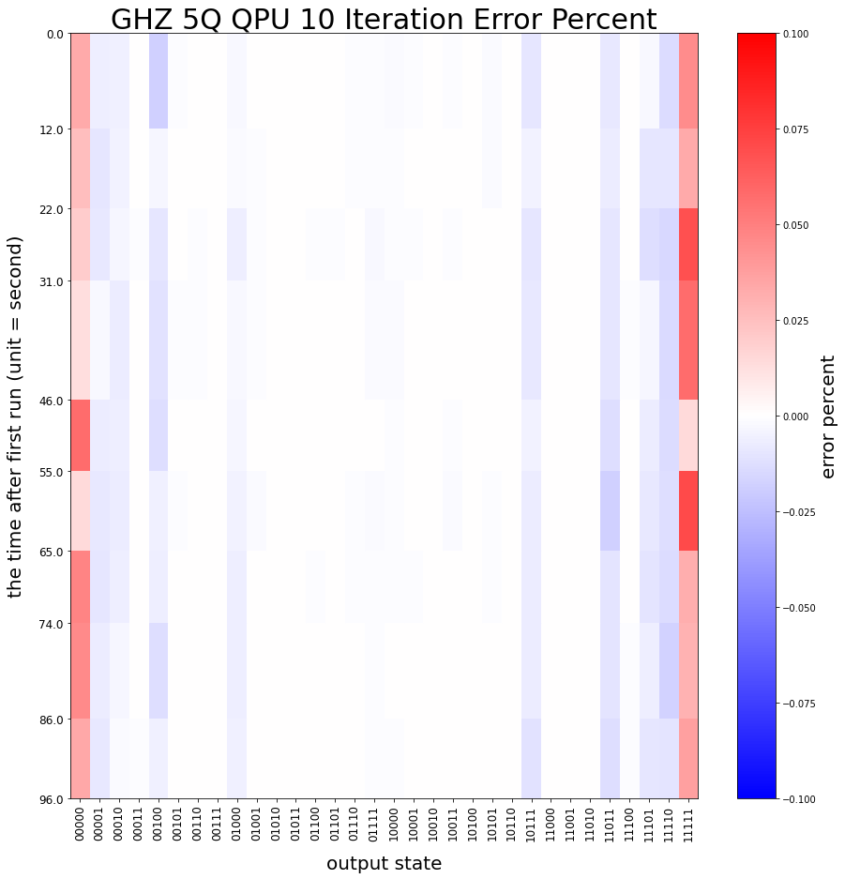
Work done 2: Get Different Data From Different Circuit

Slide 8
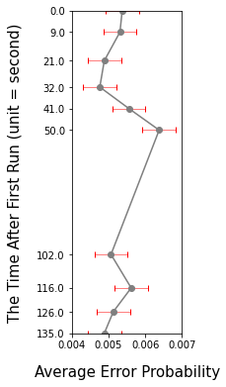
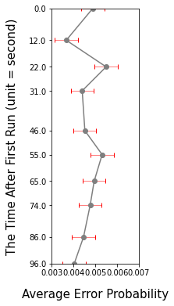
Work done 2: Get Different Data From Different Circuit
GHZ
Probability
Average
Error
Total
Average
error
Errors
Circuit1
0.0055
Circuit2
0.0052
Circuit3
0.0046

Slide 9
Discussion
QPU Queue

Slide 10
Discussion
+ XGate

